Slide 1

Bean & GONE
Project update

Slide 2


.css – each have own branding & own .css
Sinead’s – a modified version of Robo’s logo design
Individualized CSS look for the site.
Went with Orange.
I dropped the bottom line as it didn’t work in the dark sidebar nav
Rob’s logo design

Slide 3
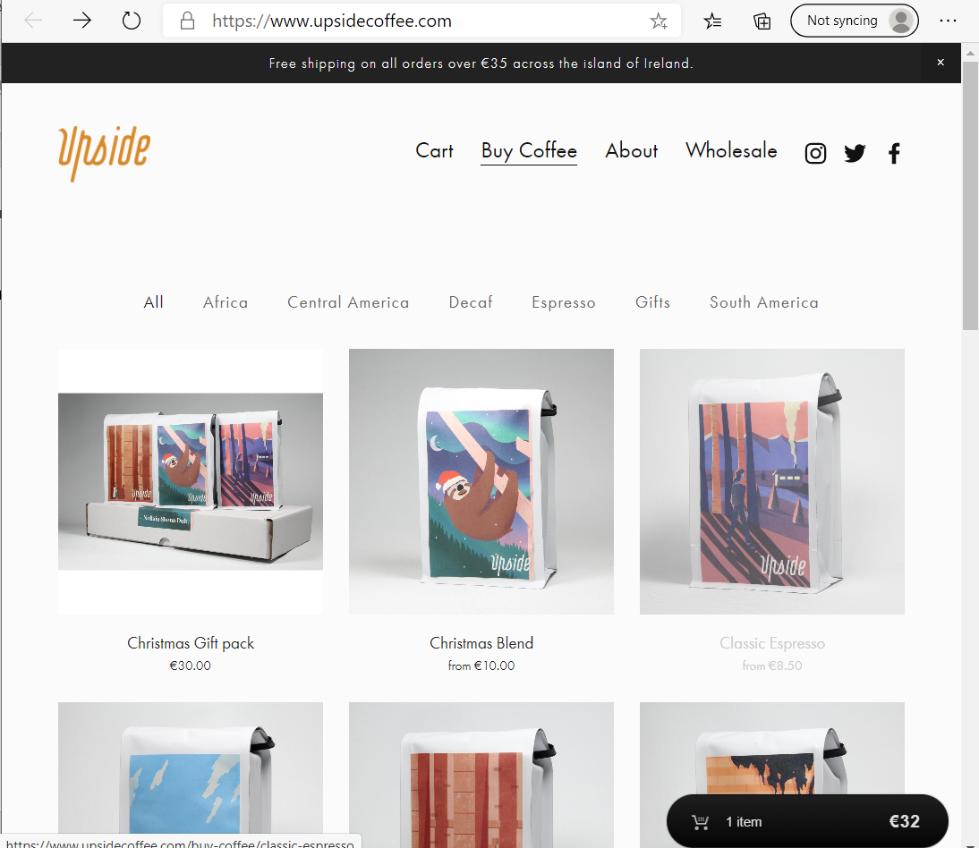
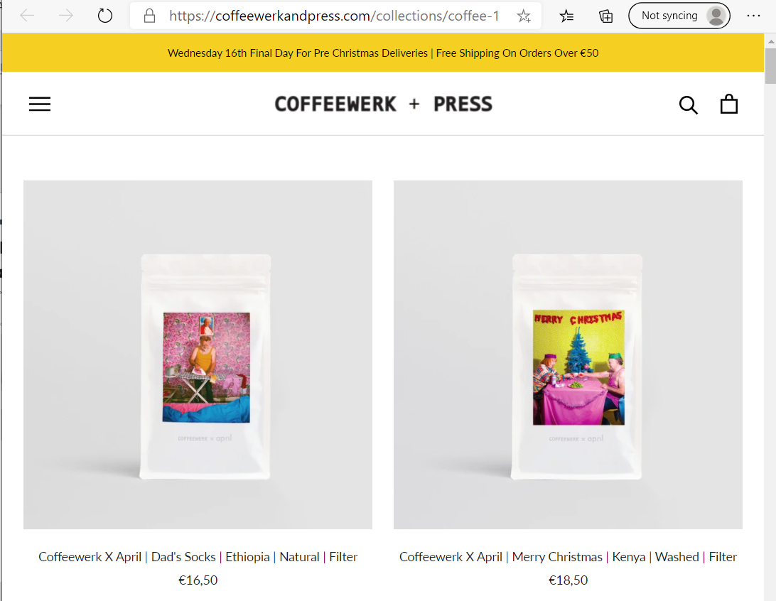
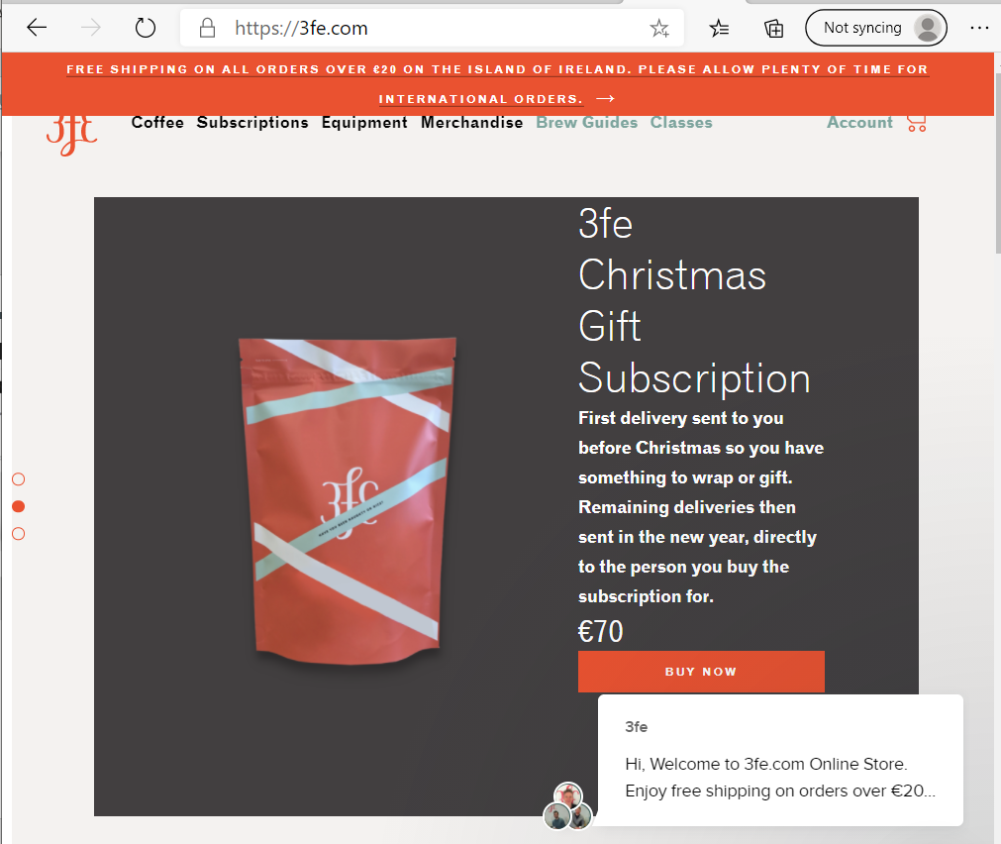
Design process – based on 3 sites rob suggested
Liked clean lines and square effects
Like space
Liked Orange as contrast colour

Slide 4
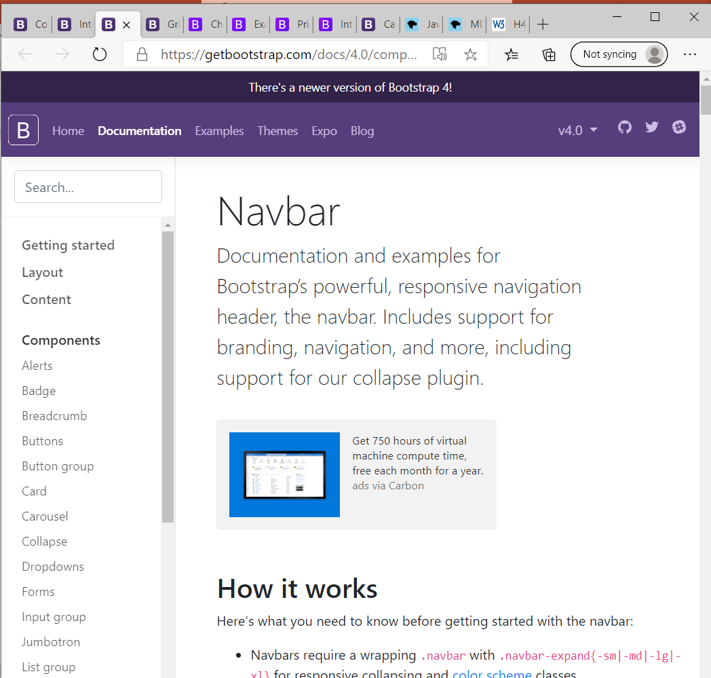
Liked Side BAR nav The example code from bootstrap provided great ideas

Slide 5
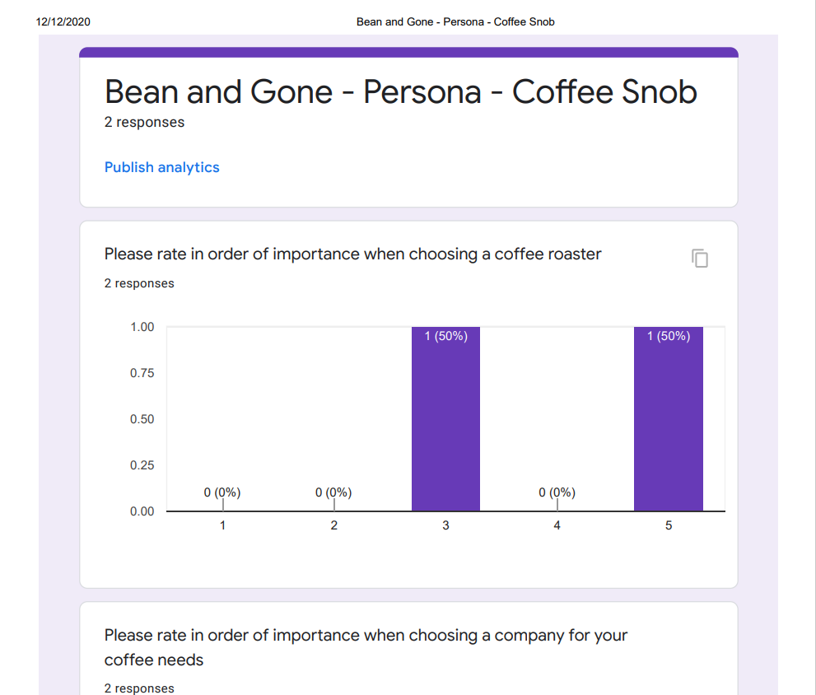
Research – Survey’s and interviews ------
Carried out surveys.
Also interviewed/talked with
Team J and asked them to explain their survey answers as they went did the survey.
Feedback:
Light mode
Ease of navigation
Liked a landing page with top options available to click on (image preferred)
Fairtrade, ecologically sourced

Slide 6
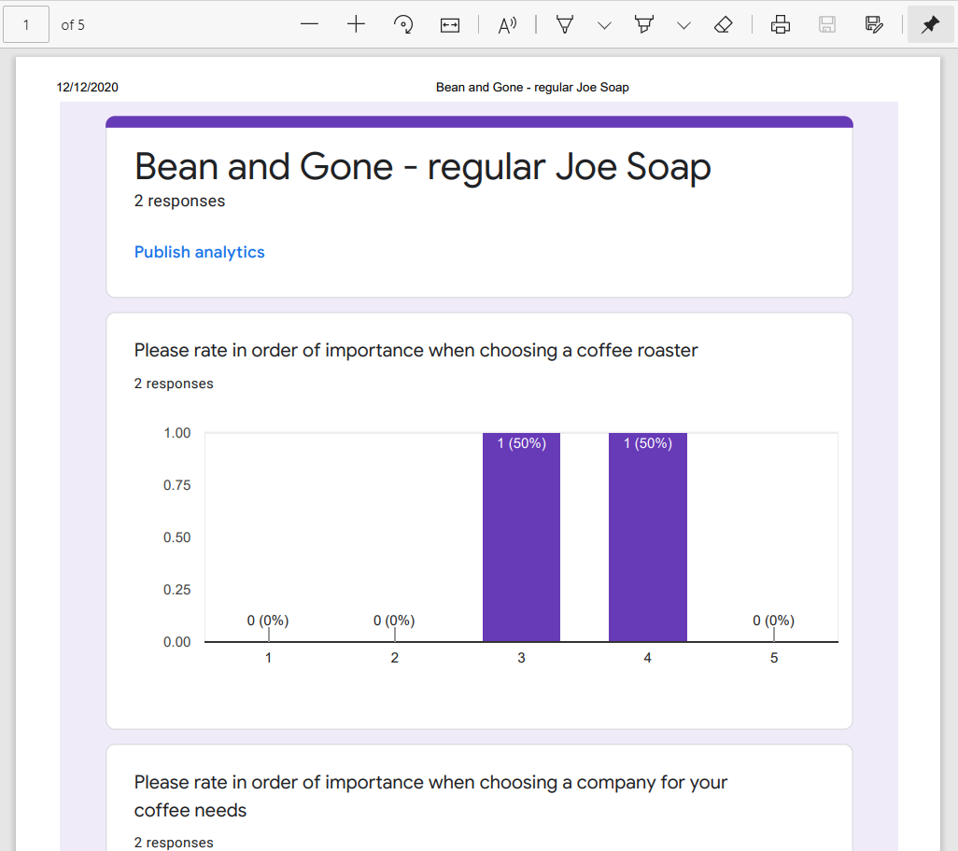
Research – Survey’s and interviews
Feedback:
They liked TOP nav bar.
However, both myself and Rob preferred to use a side nav bar (at least for larger screen sizes) so we stuck with our preference.

Slide 7
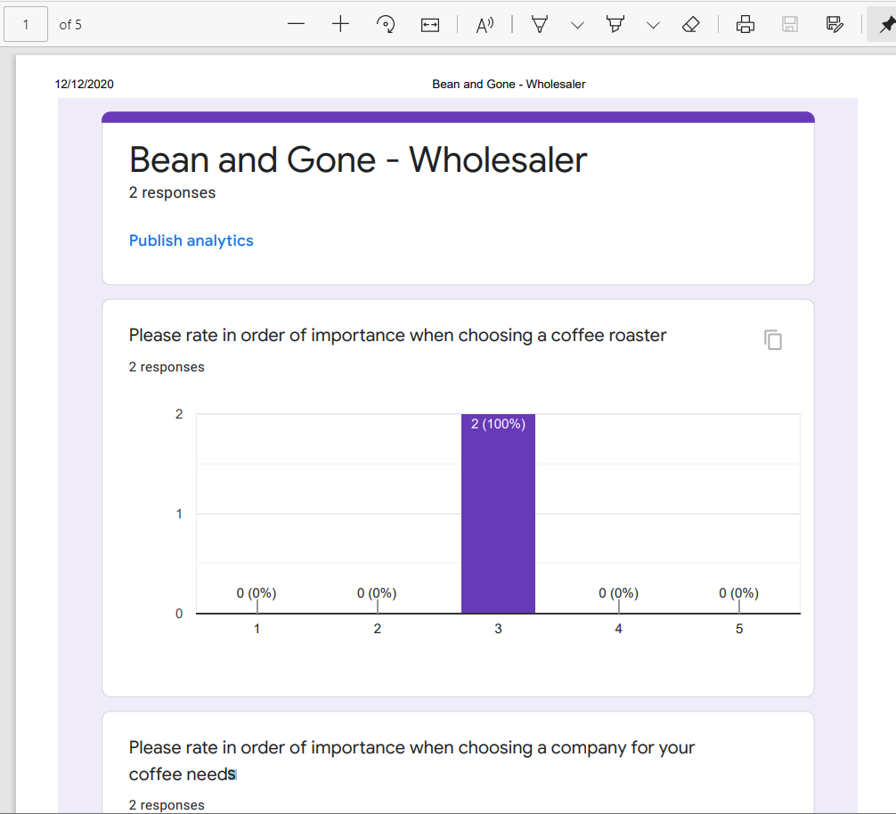
Research – Survey’s and interviews

Slide 8
Bean & Gone
Index.html
About
Subscriptions
Coffee Merchandise
Coffee Menu
Wholesale
Product page
Sitemap for Bean & Gone – Sinead Bradley & Rob Gardner

Slide 9
Bean & Gone
Index.html
FAQ
Privacy
Terms & Conditions
Site map
Sitemap for Bean & Gone – will do these extra pages if there is time

Slide 10
Bean & Gone
bearandgone@gmail.com
https://twitter.com/beargone1
https://www.facebook.com/bear.andgone.5/
https://sinead-dotcom.github.io/beanAndGone/
Social Media & E-mail presence
Git pages for deployment

Slide 11
Project Plan

